Slide 1
The Diversity of Writing Systems
A
文
by Simon Ager
Ω
ك

Slide 2
Summary
Writing systems of Europe
Writing systems of Africa
Writing systems of North America
Writing systems of Asia
Writing systems of Oceania
Constructed scripts

Slide 3
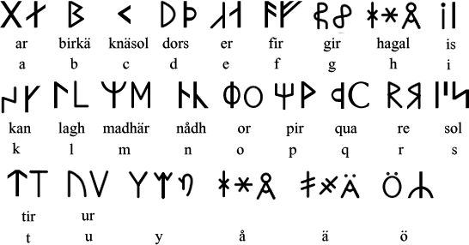
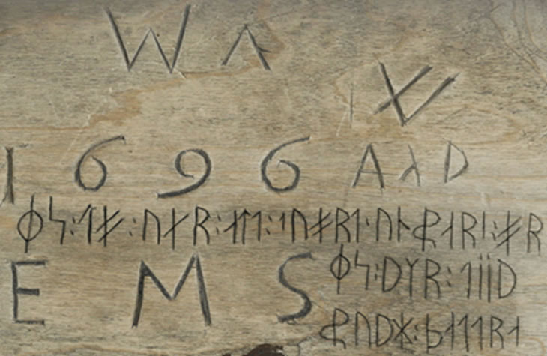
Writing systems of Europe
Dalecarlian Runes
Source

Slide 4
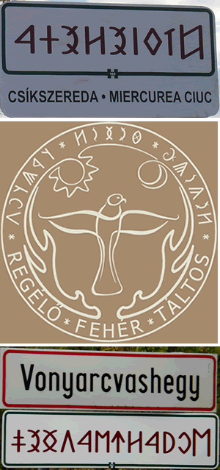
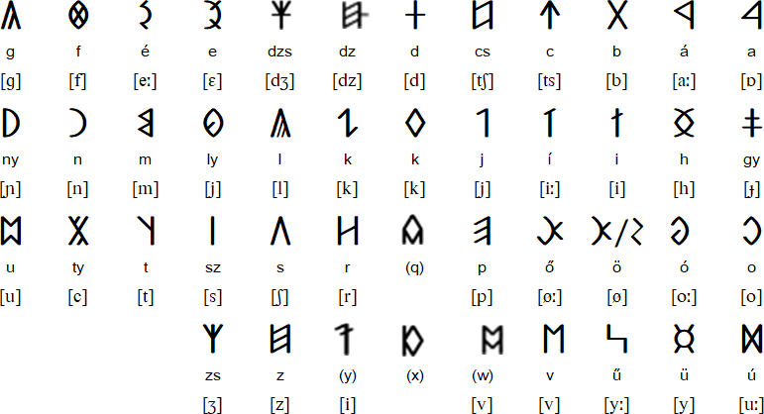
Writing systems of Europe
Old Hungarian alphabet

Slide 5
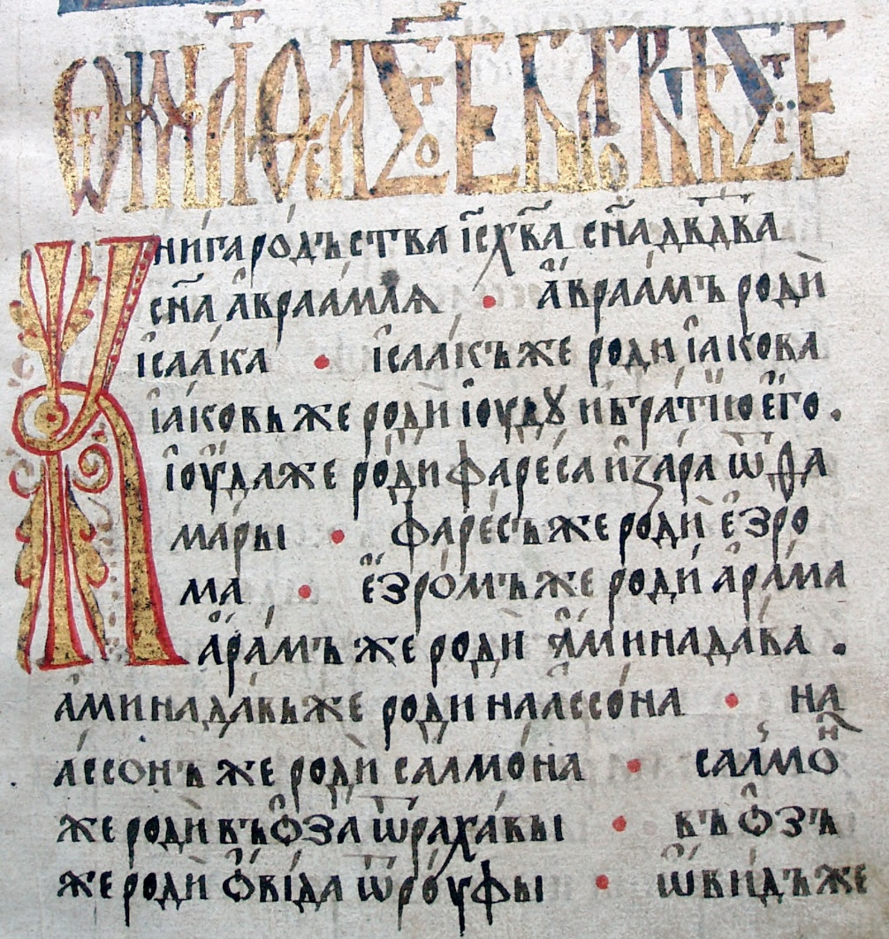
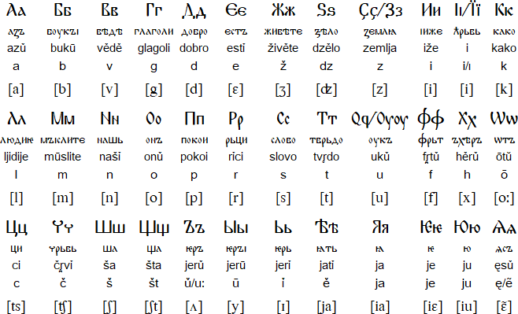
Writing systems of Europe
Old Church Slavonic
Source

Slide 6
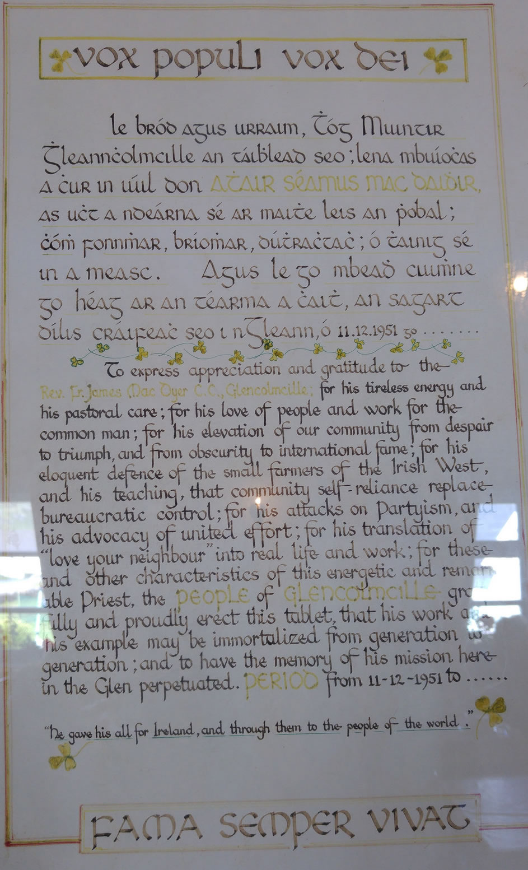
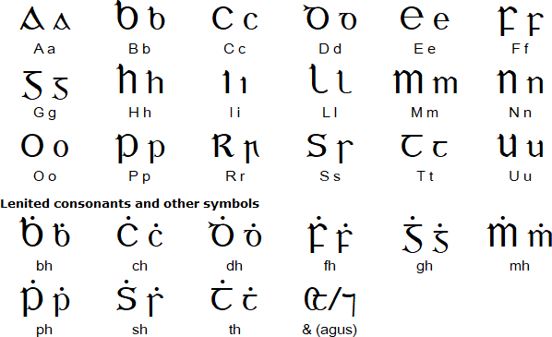
Writing systems of Europe
Gaelic script / cló gaelaċ

Slide 7
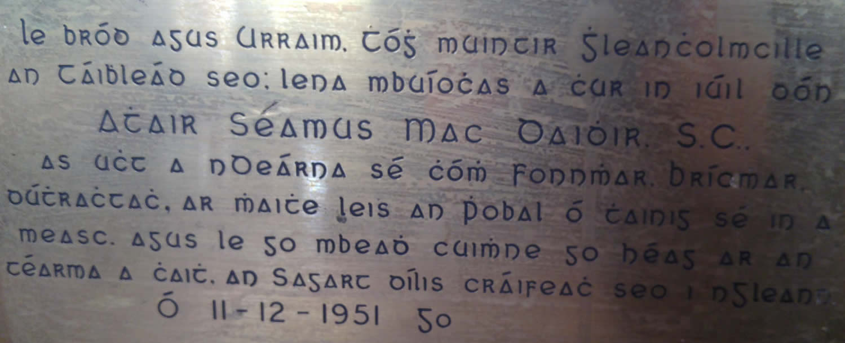
Writing systems of Europe
Gaelic script / cló gaelaċ

Slide 8
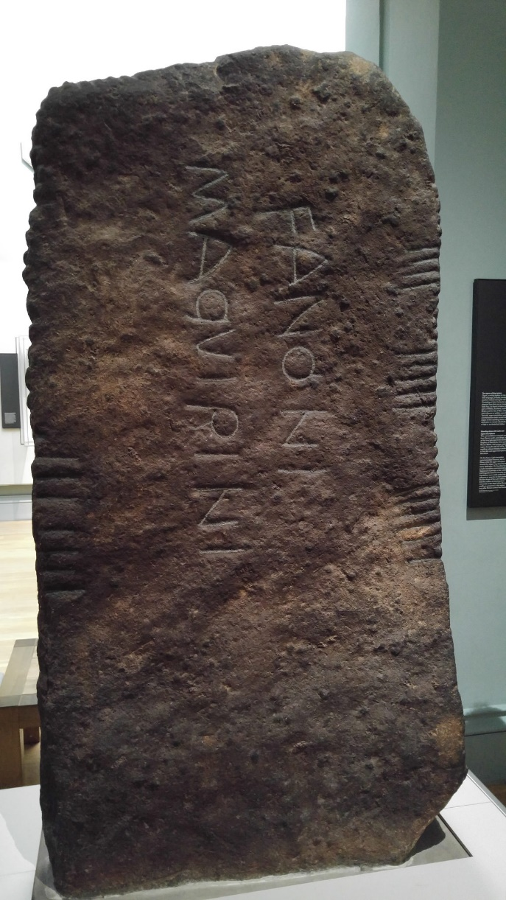
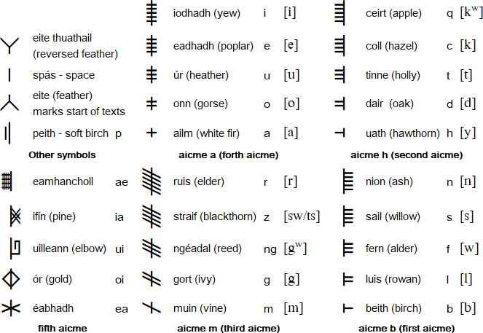
Writing systems of Africa
Ogham / ᚛ᚑᚌᚐᚋ᚜

Slide 9
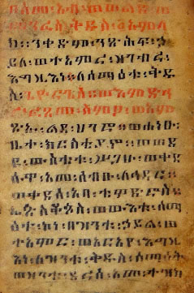
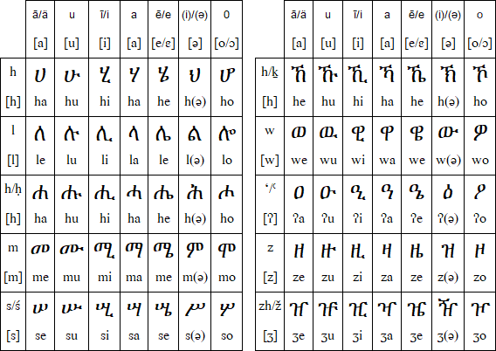
Writing systems of Africa
Ge‘ez script (ግዕዝ)
Source

Slide 10
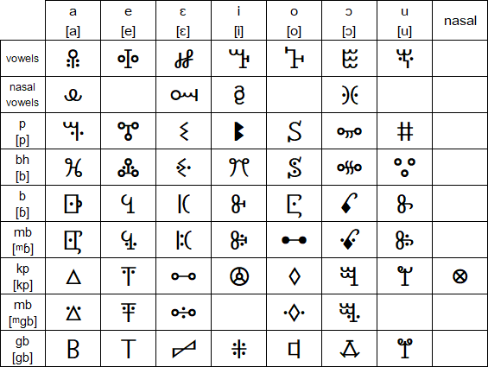
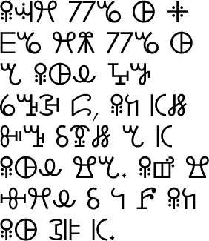
Writing systems of Africa
Vai (ꕙꔤ)

Slide 11
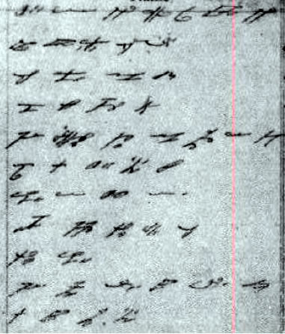
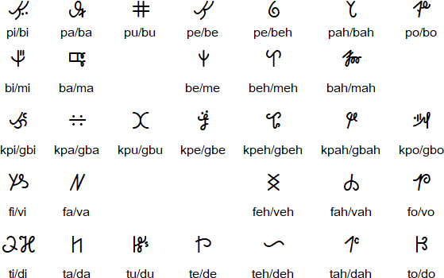
Writing systems of Africa
Kpelle
Source

Slide 12
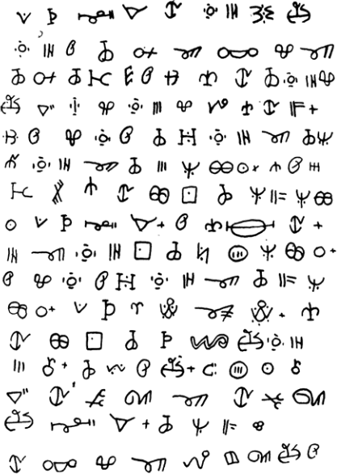
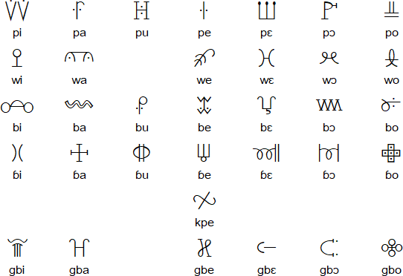
Writing systems of Africa
Loma
Source

Slide 13
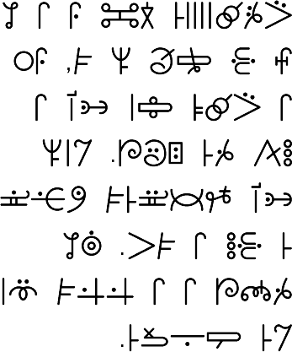
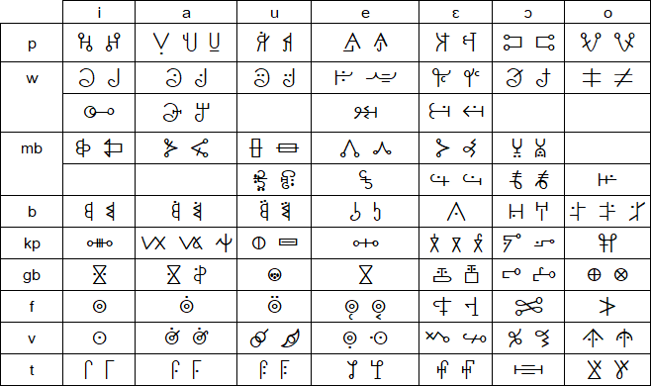
Writing systems of Africa
Mende (ki-ka-kui)

Slide 14
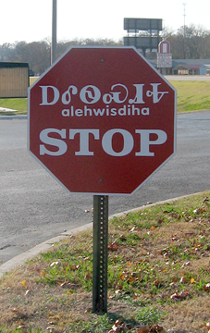
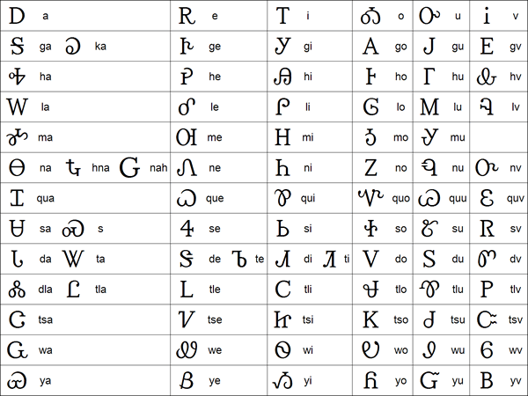
Writing systems of North America
Cherokee (ᏣᎳᎩ / Tsalagi)
Source

Slide 15
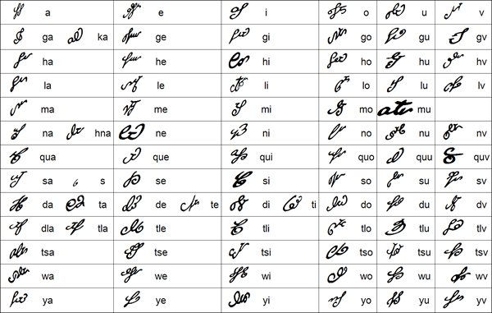
Writing systems of North America
Cherokee (ᏣᎳᎩ / Tsalagi)
Source

Slide 16
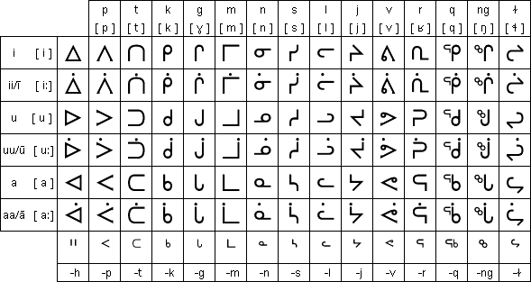
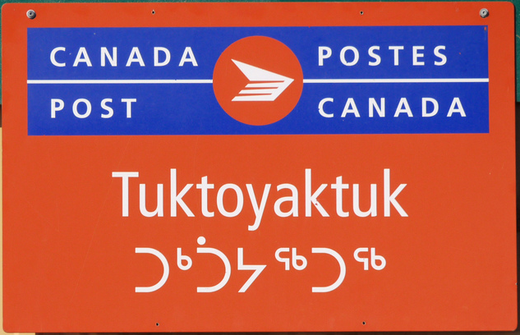
Writing systems of North America
Inuktitut syllabics (ᑎᑎᕋᐅᓯᖅ ᓄᑖᖅ)
Source

Slide 17
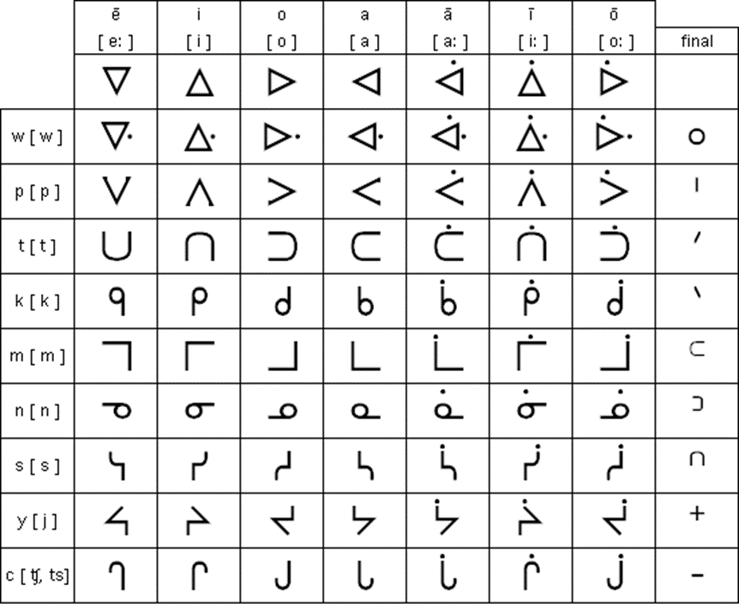
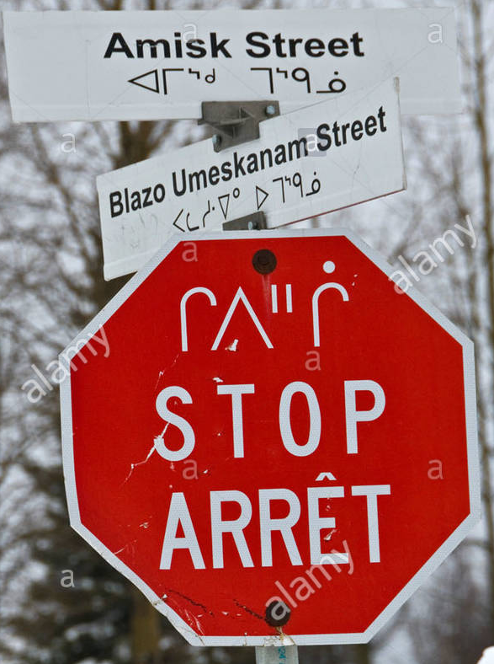
Writing systems of North America
Cree syllabics
Source

Slide 18
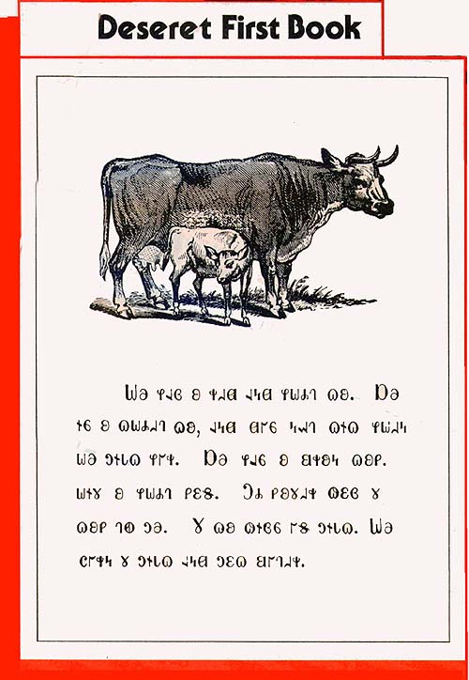
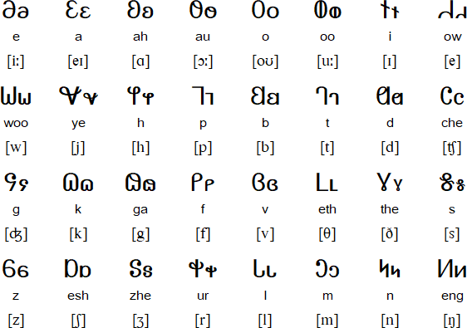
Writing systems of North America
Deseret alphabet (𐐔𐐯𐑅𐐨𐑉𐐯𐐻)
Source

Slide 19
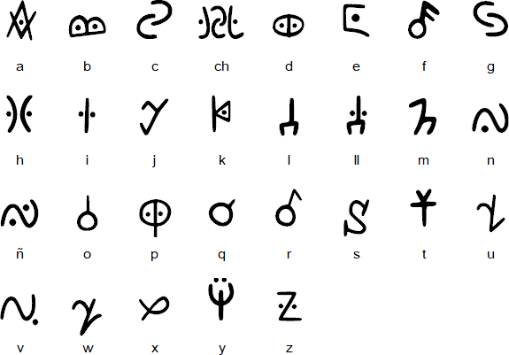
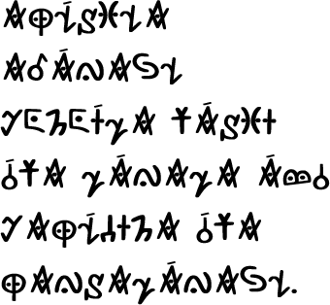
Writing systems of North America
Naguaké Taíno Pictographic Alphabet

Slide 20
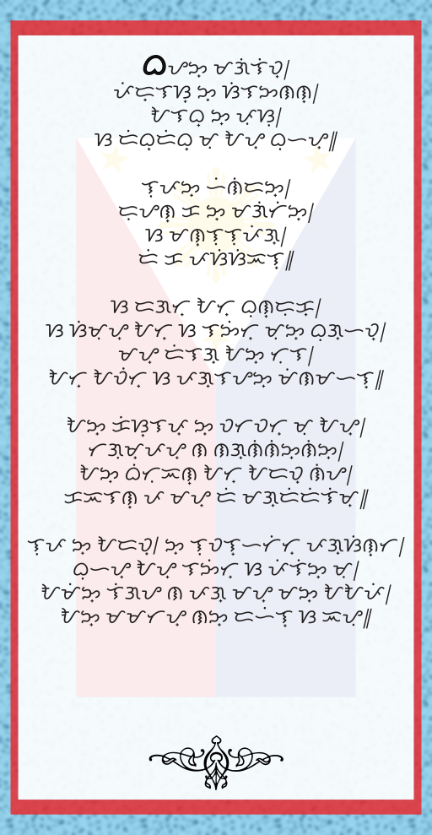
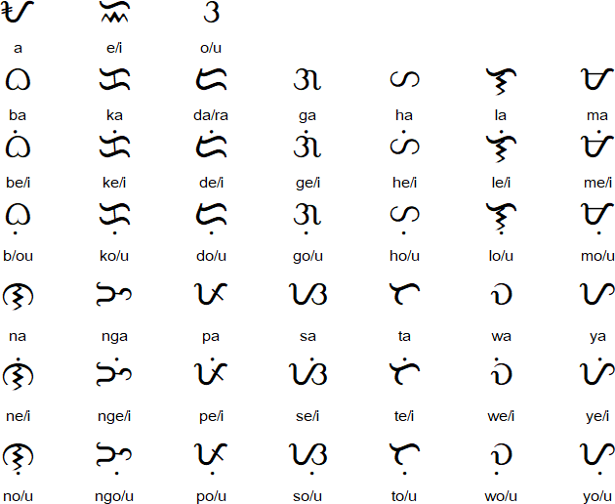
Writing systems of Asia
Baybayin Script
Source

Slide 21
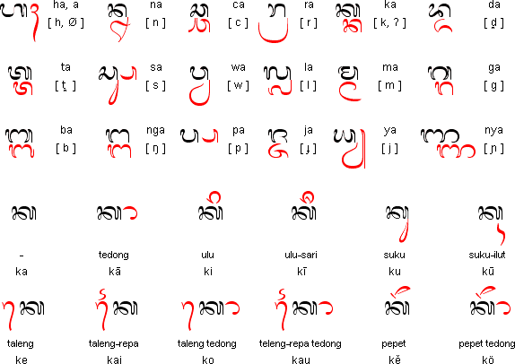
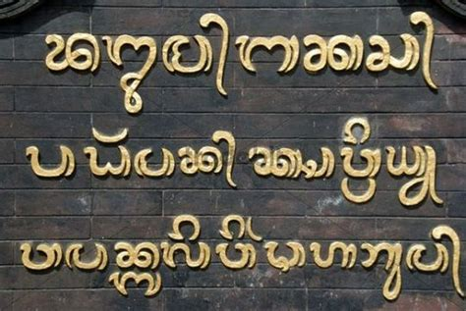
Writing systems of Asia
Balinese (Aksara Bali / Hanacaraka)
Source: sign on Pura Besakih temple, Bali, Indonesia

Slide 22
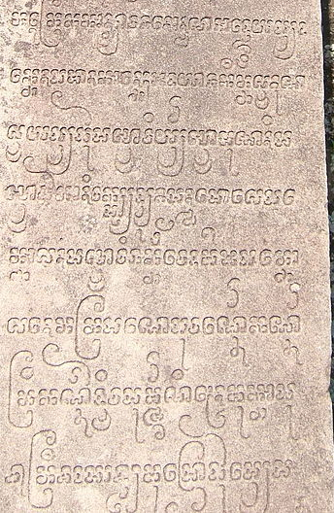
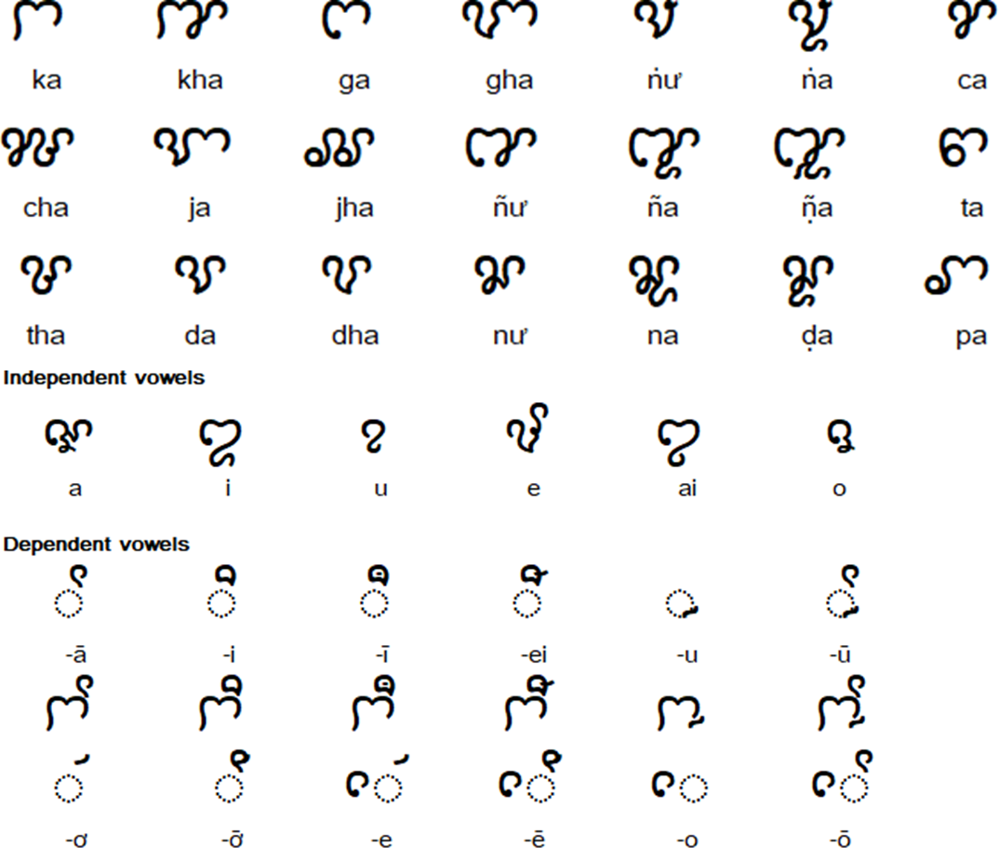
Writing systems of Asia
Cham
Source

Slide 23
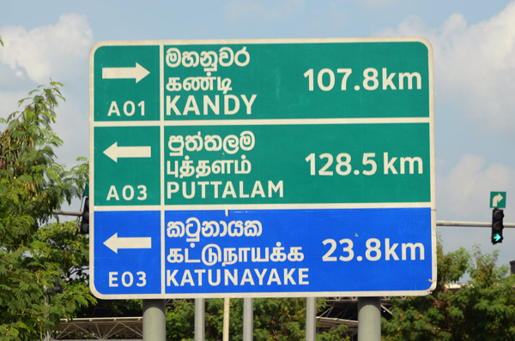
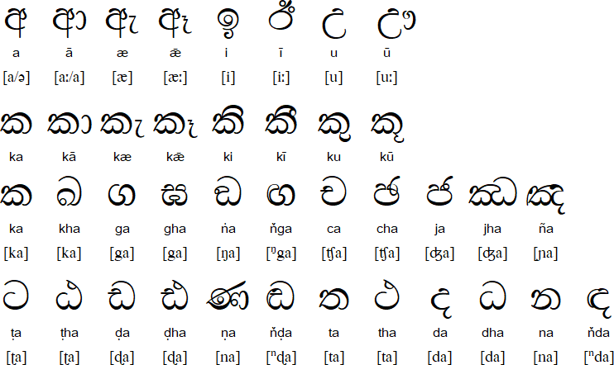
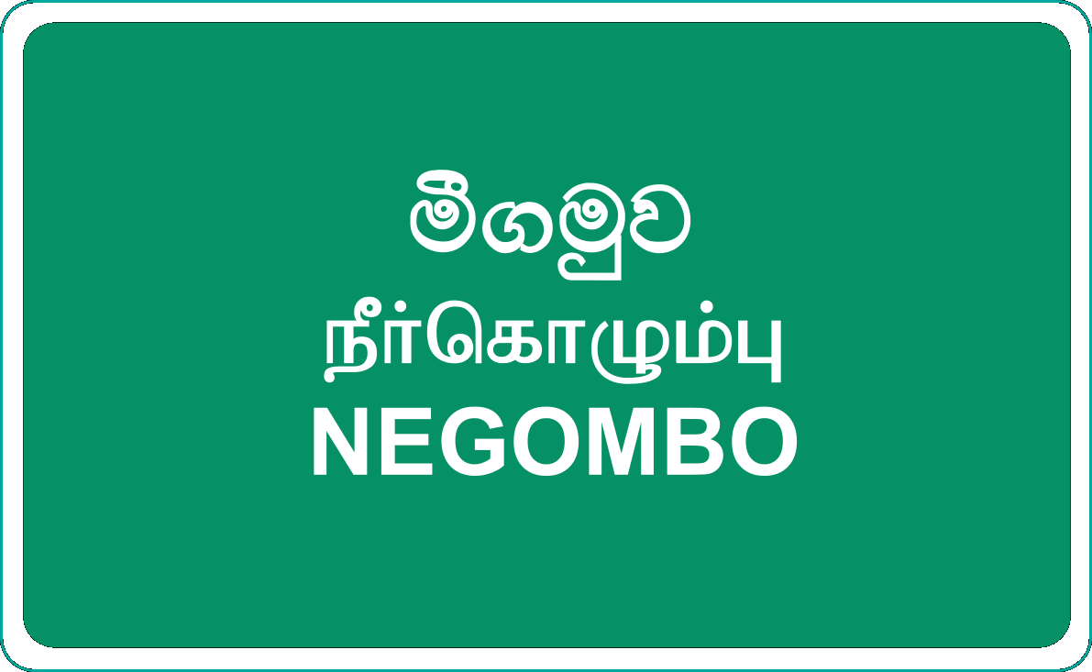
Writing systems of Asia
Sinhala (සිංහල)
Source
Source

Slide 24
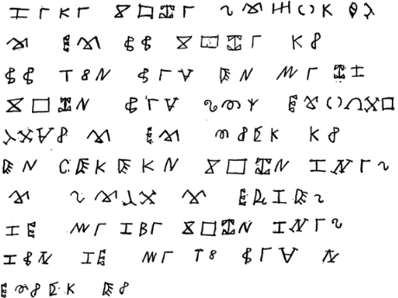
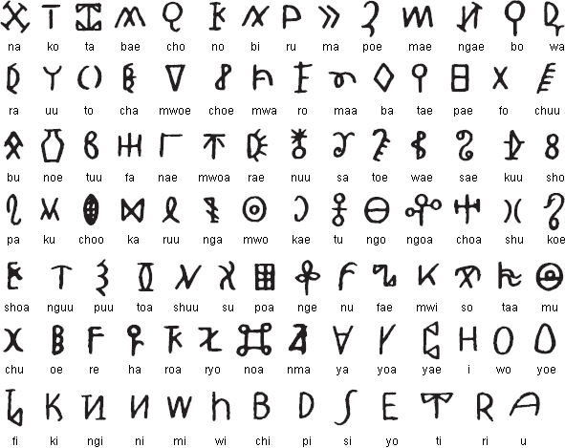
Writing systems of Oceania
Caroline Island Script
Source

Slide 25
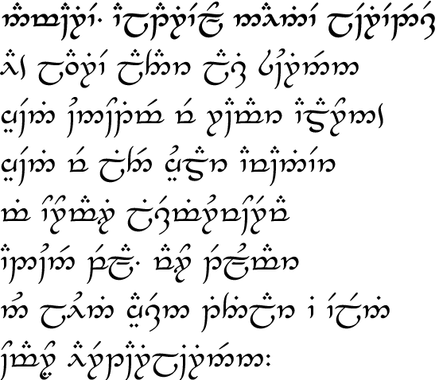
Constructed scripts
Tengwar
Namárië. Altariello Nainië Lóriendessë
Ai! laurië lantar lassi súrinen, yéni únótimë ve rámar aldaron! Yéni ve lintë yuldar avánier mi oromardi lissë-miruvóreva Andúnë pella, Vardo tellumar nu luini yassen tintilar i eleni ómaryo airetári-lírinen.
Farewell. Galadriel's Lament in Lorien
Ah! like gold fall the leaves in the wind, long years numberless as the wings of trees! The long years have passed like swift draughts of the sweet mead in lofty halls beyond the West, beneath the blue vaults of Varda wherein the stars tremble in the voice of her song, holy and queenly.

Slide 26
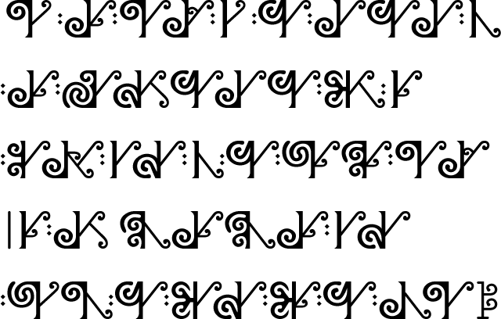
Constructed scripts
New Maori
Transliteration
Ko te katoa o nga tangata i te whanaungatanga mai e watea ana i nga here katoa; e tauriterite ana hoki nga mana me nga tika
Translation
All human beings are born free and equal in dignity and rights.

Slide 27
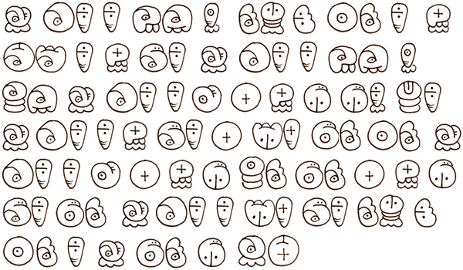
Constructed scripts
Sitelen
Transliteration
jan ali li kama lon nasin ni: ona li ken tawa li ken pali. jan ali li kama lon sama. jan ali li jo e ken pi pilin suli. jan ali li ken pali e wile pona ona. jan ali li jo e ken pi sona pona e ken pi pali pona. jan ali li wile pali nasin ni: ona li jan pona pi ante.
Translation
All human beings are born free and equal in dignity and rights. They are endowed with reason and conscience and should act towards one another in a spirit of brotherhood.

Slide 28
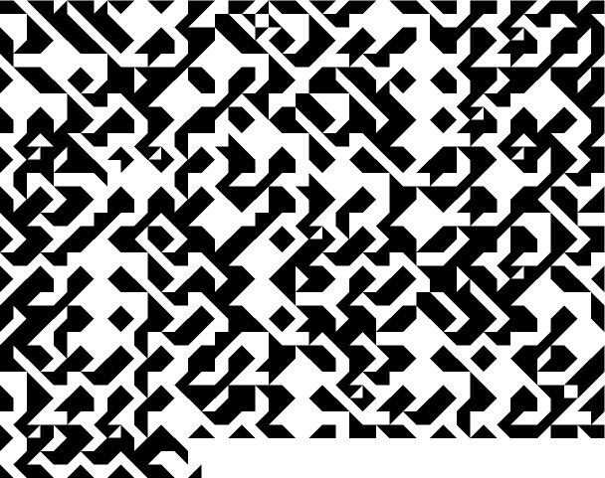
Constructed scripts
Betamaze
Transliteration
All human beings are born free and equal in dignity and rights. They are endowed with reason and conscience and should act towards one another in a spirit of brotherhood.

Slide 29
Thank you / Merci / Diolch / 謝謝 Go raibh maith agaigh / Danke Gracias / Dankon / спасибо / Tack ありがとう / Tapadh leibh / Hvala lepa

Slide 30
Web: Omniglot.com Blog: Omniglot.com/blog Podcast: Omniglot.com/radio Email: feedback@omniglot.com Presentation: omniglot.com/diversityofwriting.pptx

